Slide 1

Heredity and Evolution
Life of Mendel

Slide 2
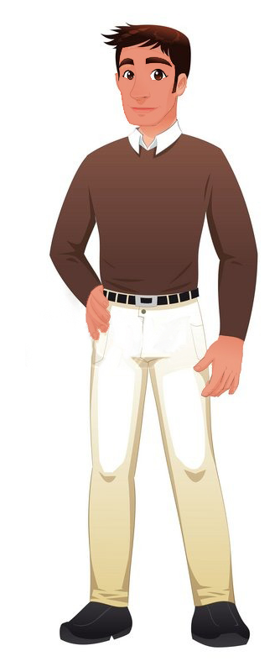
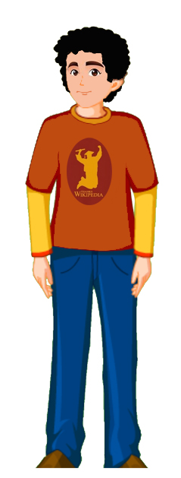
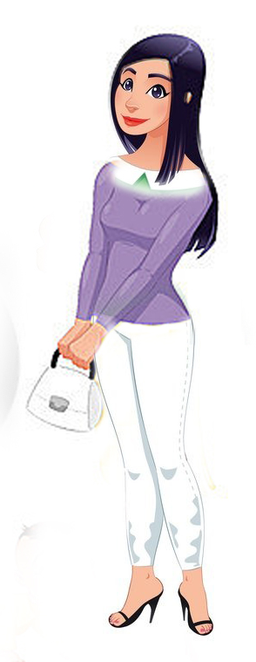
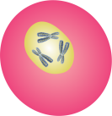
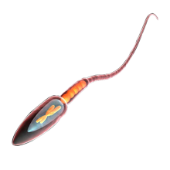
Mother and father contribute equal quantity of genes,
When contribution is equal
then why different trait of the child
2n
and if different trait then what percentage of traits goes to offspring from parents
n
n
Father
Child
Mother

Slide 3

To answer all these unanswered questions…..

Slide 4
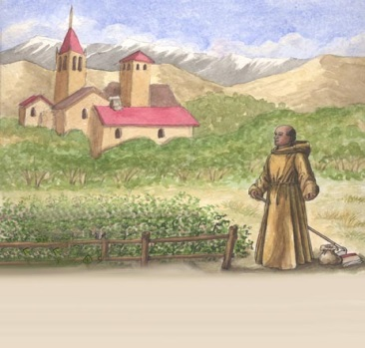
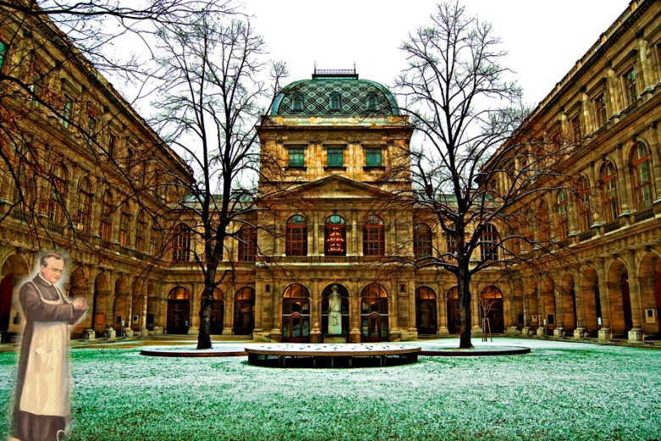
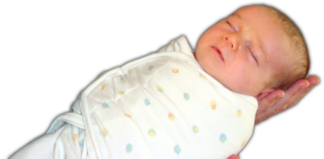
He went in a monastery for education
Then he went on to study science and mathematics at the University of Vienna.
A child is born on 20 july 1822

Slide 5
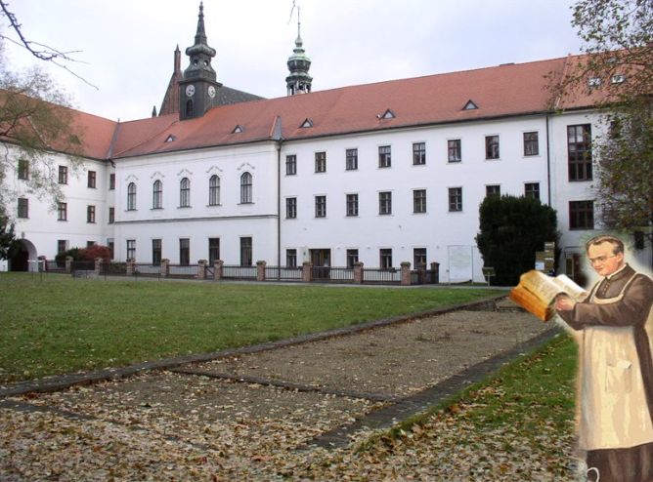
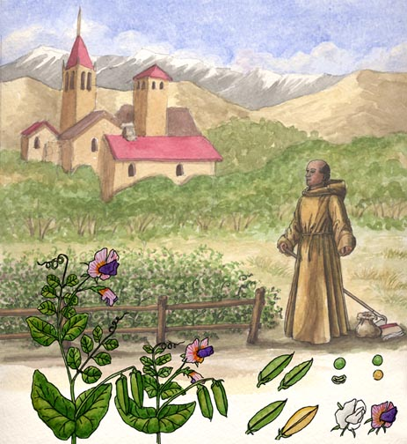
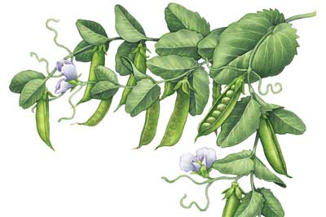
He went back to his monastery and started growing peas.
He appeared in the examination for teaching certificate and failed.
But the failure did not suppress his zeal for scientific quest.

Slide 6
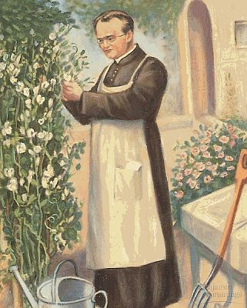
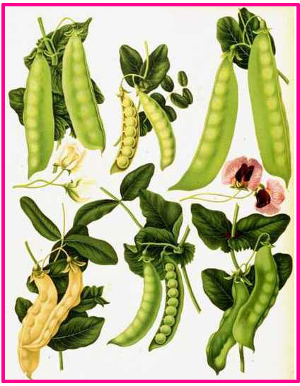
This helped him to arrive at the laws of inheritance
Mendel blended his knowledge of science and mathematics and was the first one to keep count of individuals exhibiting a particular trait in each generation.

Slide 7
Thank You

